Slide 1
OFFENSIVE SYSTEM AND NETWORK SECURITY
BY: MANAN JAIN

Slide 2
Agenda
Whoami?
Quick Recap of nmap scans.
Pivoting Techniques- Tunneling into internal network
NAC Implementations & Bypasses
Privilege Escalation Techniques.

Slide 3
Who am i?
Security Researcher Mostly delving into offensive side of the security.
CTF Player
Web3 Enthusiast
Synack Red Team Member
OSEP | OSCP | CRTO | CRTE | eCPTXv2 | eCPPTv2 | eJPTv2 Certified
Let’s Connect: https://linkedin.com/in/mananjain97
Medium: https://medium.com/@manan07

Slide 4
Quick Recap of Nmap scans
TCP SYN SCAN: (-sS) A TCP SYN Scan is a stealth scan used to determine if ports on a target system are open, closed or filtered. Nmap sends a SYN packet to the target and waits for a response. If the target responds with SYN/ACK packet, the port is considered open and ready to establish a connection. Also known as half open scan since it is a two-way communication channel and scanner doesn't close the open connections
TCP FIN SCAN: (-sF) Mostly used by attackers in order to bypass the deep inspection firewalls and other scan detection programs. Closed ports will respond with reset response while opened ports will ignore the packet.
TCP XMAS SCAN: (-sX) Used to identify listening ports on the server
TCP NULL SCAN: (-sN) Extremely stealthier scan as it sets all header values to null
TCP SCRIPT & VERSION SCAN: (-sCV) Used to detect version and run nmap scripts for identifying vulnerabilities .
Aggressive Scan: (-A) It provides comprehensive set of details about target system like service detection & os detection, running nmap scripts.
For more checkout https://nmap.org/book/

Slide 5
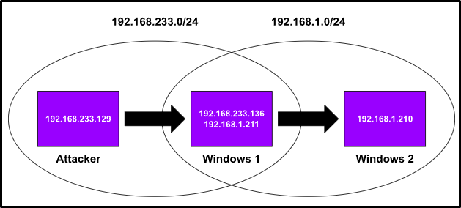
Pivoting & Tunneling
What is Pivoting & Tunneling?
Pivoting is using a compromised system to access other systems within a network.
Tunneling involves encapsulating network traffic within another protocol to bypass firewalls.
Example: After compromising a machine, an attacker uses it as a pivot to scan and exploit other internal systems.

Slide 6


Ways to Pivot into network
1. SSH Dynamic port forwarding.
2. SSH Local Port Forwarding.
3. Chisel / FRP
4. Ligolo-NG
5. Sshuttle
6. HTTP Agents – pivotnacci, Neo-reGeorg, ABPTTS

Slide 7
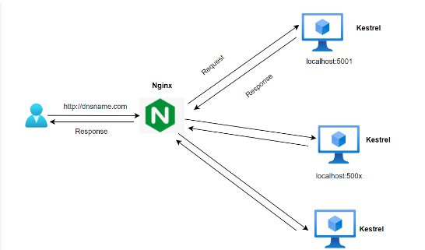
Pivoting using HTTP Agents
Scenario:
I have gained RCE and uploaded a webshell on a server which is a reverse proxy allowing only HTTP traffic and there is no internet connection in the internal network. Which means only port 80 & 443 is exposed to the internet that too via a nginx reverse proxy
Limitations: I can’t use Ligolo-ng, chisel, sshuttle or any other tool that require to establish a reverse connection with a VPS over internet.

Slide 8
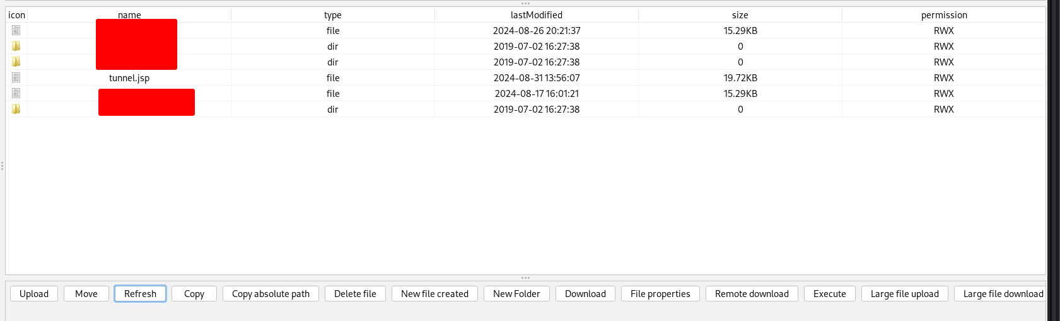

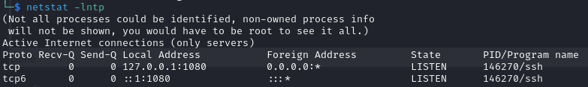
Pivoting using HTTP Agents
Remember ssh Dynamic Port Forwarding? PORT 1080 ?

Slide 9
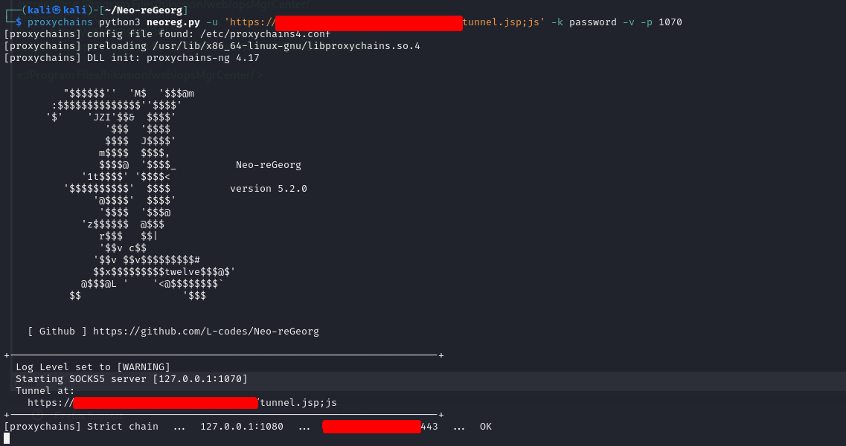
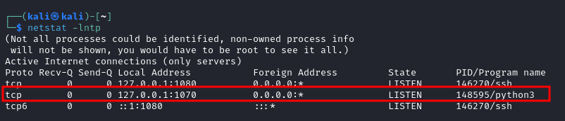
Let’s Pivot :D !!!

Slide 10

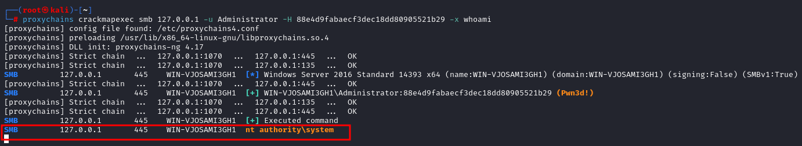
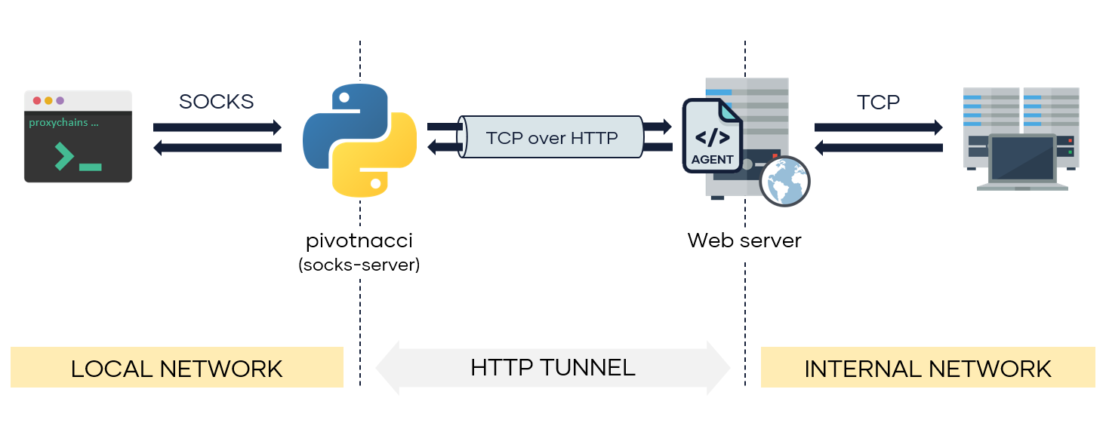

Slide 11
NAC(Network Access Controls) Implementation
NAC can be implemented in a variety of ways. The big manufacturers offer packages that include hardware with the necessary features and software (agent and administration server). In some cases, cross-vendor implementations are available, although these typically have a more limited range of features and may also require more effort to configure.
The following two methods are usually used for the authentication of devices:
MAC-based: The device is identified at the switch by verifying the MAC address and then granting authorization with access control lists (ACL) for the network.
Certificate-based: The device sends its locally installed 802.1x machine certificate to the switch, which then uses ACLs to verify the validity in order to allow access.
Then there are two common methods used for compliance checks:
Agent: A software agent is installed on the device. This must be configured with the defined policies. If the device meets the required criteria, it is allowed to access the network.
Scanner: A vulnerability scanner that scans the device in a special zone is one alternative. The results are sent to the NAC server and checked against the relevant policies.
NAC is intended to address two issues:
Authentication: Only authorized devices should be granted access to the network, such as an employee’s personal laptop. In contrast, a hacker’s harmful devices should be blocked from the network.
Compliance: Authenticated devices are granted authorization when they meet additional criteria. These include passing tests for current antivirus patterns and OS patch level requirements.

Slide 12
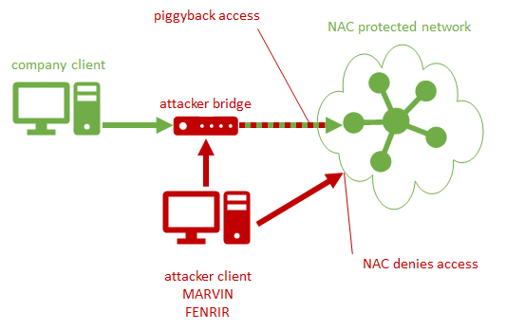
NAC BYPASSES
MAC Spoofing
802.1x bypass
Dropbox (Raspberry Pi 4+kali arm image)

Slide 13
MAC(Media Access Control) Spoofing
The first step in spoofing an authorized MAC address is to find one. This can be done by physically searching addresses on printers, labels, IP phones and similar equipment, or by using Wireshark to manually inspect broadcast and multicast packets that travel on the network and obtain some MAC addresses in the traffic.c.
Macchanger(already installed in kali) can then be used to spoof the a MAC address. Once there, cables can be swapped to access the customer's network.
# manually set the address
macchanger -m "AA:BB:CC:DD:EE:FF" eth0
# reset the address to the permanent physical MAC
macchanger -p eth0
Some errors may be raised when the interface settings cannot be changed. This is usually due to the interface being used. Which can be solved by following:
ifdown eth0
macchanger -m "AA:BB:CC:DD:EE:FF" eth0
ifup eth0

Slide 14
MSCHAP-V2 Authentication
Scenario: A client has asked you to perform physical breach / assumed breached red teaming or internal penetration testing. You are provided with a Domain User ID ( On-Prem ) and a laptop/desktop(maybe/maybe not) which is connected to the Enterprise WiFi for accessing internal network and authenticate to DC(Domain Controller). You’re supposed to proceed further onwards.
Limitations: There’s a possibility that an EDR agent is installed which is blocking all your tools and executable binaries.
You are not so familiar with EDR bypasses.
Domain user provided does not have local administrative rights on the given Desktop/Laptop.
Read More about MSCHAP-V2 authentication here: https://www.portnox.com/cybersecurity-101/mschapv2/
What can we do?
Pull out the ethernet cable attached to the given desktop and plug into your own personal/company provided laptop and do the enumeration, recon on network by running nmap and other tools after spoofing the MAC of the Client’s machine.
Use the Domain User credentials to authenticate over WiFi through your own machine in order to access the internal network.

Slide 15
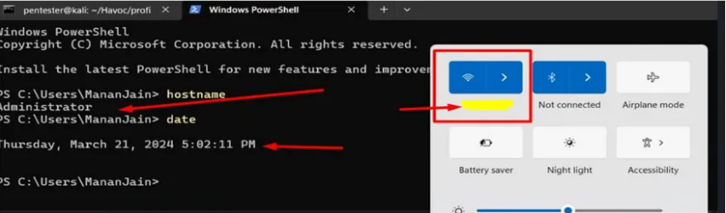
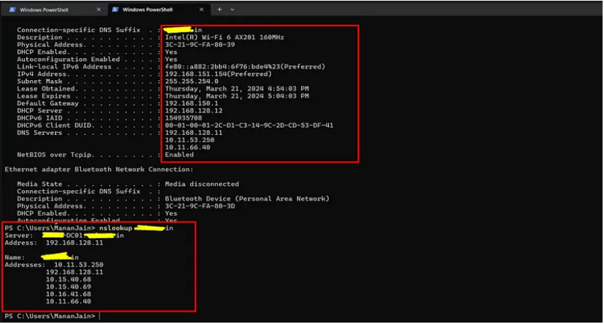
Eg. Physical Breach To Domain Admin
Ref: https://medium.com/@manan07/uncommon-physical-breach-to-domain-admin-compromise-b8bcf5d21082

Slide 16
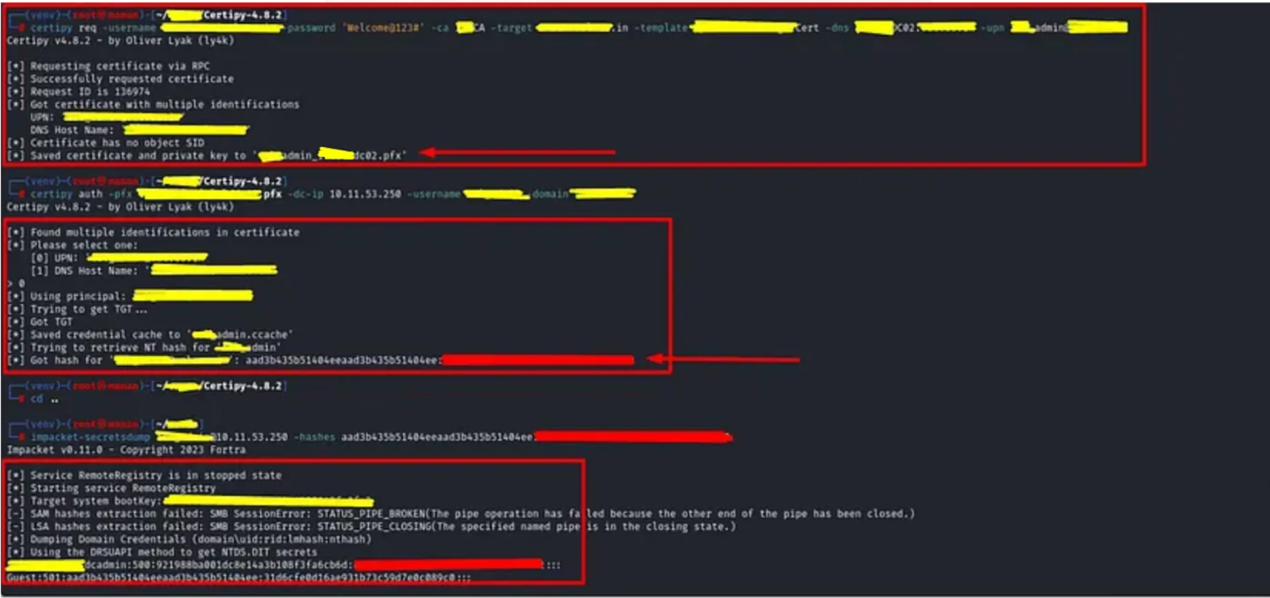

Slide 17
Privilege Escalation
A privilege escalation attack is a cyberattack designed to gain unauthorized privileged access into a system. – Definition by CrowdStrike
The art of elevating the rights from a low level user to high privilege user by exploiting a vulnerability or abusing a misconfiguration . – My own Definition
Windows | Linux
Abusing MSI files. Abusing misconfigured services Abusing scheduled tasks. Kernel Exploits(0days) Relay Attacks DLL Hijacking Offline Sam Dumping Delegation Attacks Password Spray Attack | Kernel Exploits like Dirtycow, DirtyPipe, PwnKit Exploiting services Exploiting SUID injectables Writable Sockets Exploiting Cronjobs Abusing Writable Paths Tmux, Screen sessions takeover Exploiting writable paths Exploiting capabilities

Slide 18
THANK YOU

